Slide 1
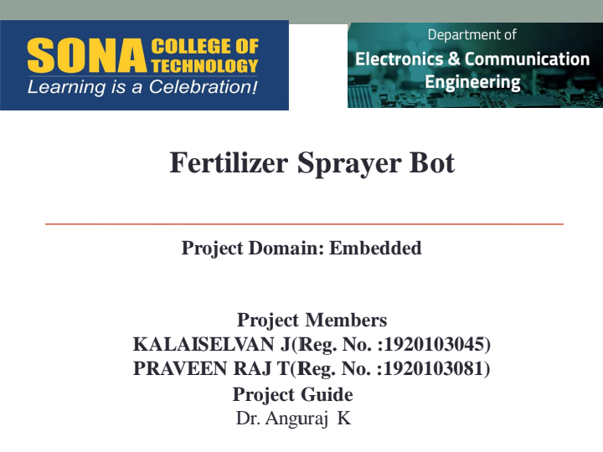
TITLE OF PROJECT: Microplastic detection in water using low cost sensors
NAME : Priethwin R (61782324103123)
Andhakumar S (61782324103006)
GUIDE : DR.M.Hema Kumar

Slide 2
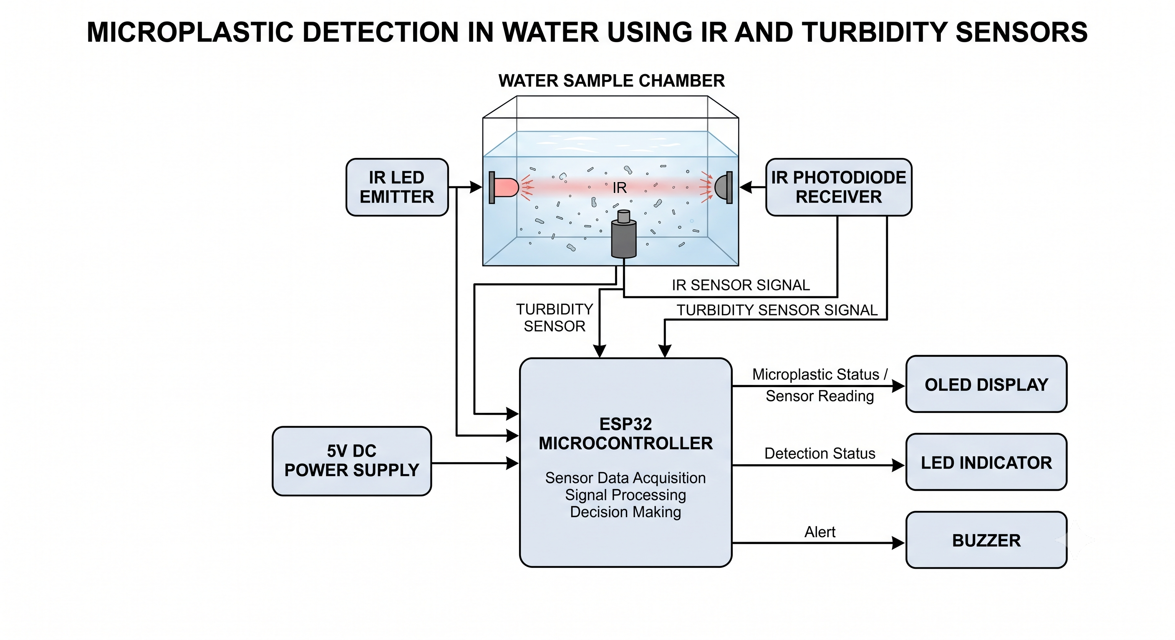

Slide 3
COMPONENTS | DETAILS IN ONE LINE | QTY | PURPOSE
sensors | IR LED + IR photodiode + turbidity sensor | 1 set | Detect optical changes and suspended particles in the water sample
Key switches | Push button switch for starting/resetting the detection process | 1 | User control for the system
Display | 0.96-inch LED/OLED display | 1 | Display microplastic detection status and sensor readings
Interface | ESP32 development board | 1 | Processes sensor signals and controls the system
Wireless connectivity | ESP32 built-in Wi-Fi/Bluetooth | 1 | Enables wireless transmission of detection data
Cloud connectivity | Blynk via ESP32 Wi-Fi | 1 | Store and monitor sensor readings remotely

